Slide 1


Java ee
(ADVANCE JAVA)
Lecture-17

Slide 2

Today’s Agenda
Introduction .
History of HTML .
Component of HTML .
Structure of HTML .

Slide 3
INTRODUCTION
HTML is a language which instructs a web – browser how data should be displayed.
It contains commands that tells the browser how the embedded data is to be displayed on the web-page.

Slide 4
Conti.
HTML stands for Hypertext Markup Language, and it is the most widely used language to write Web Pages.
Hypertext refers to the way in which Web pages (HTML documents) are linked together. Thus the link available on a webpage are called Hypertext.

Slide 5
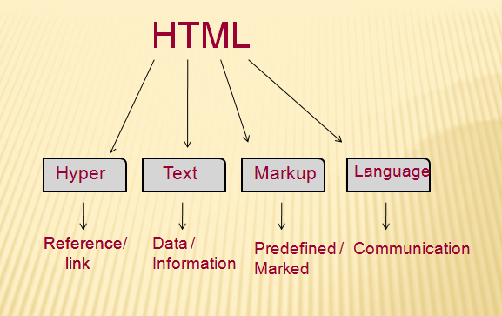
HTML

Slide 6
Conti.
As its name suggests, HTML is a Markup Language which means you use HTML to simply "mark up" a text document with tags that tell a Web browser how to structure it to display.
Originally, HTML was developed with the intent of defining the structure of documents like headings, paragraphs, lists, and so forth to facilitate the sharing of scientific information between researchers.

Slide 7
Conti.
Now, HTML is being widely used to format web pages with the help of different tags available in HTML language.

Slide 8
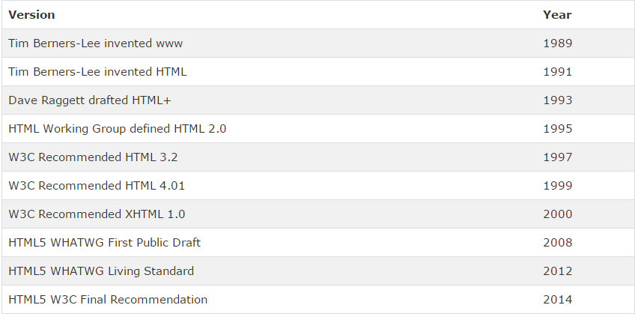
VERSIONS OF HTML

Slide 9
HISTORY
HTML was launched in 1995 .
HTML was created by Berners-Lee in late 1991 but "HTML 2.0" was the first standard HTML specification which was published in 1995.
HTML 4.01 was a major version of HTML and it was published in late 1999.

Slide 10
Conti.
Though HTML 4.01 version is widely used but currently we are having HTML-5 version which is an extension to HTML 4.01, and this version was published in 2012.

Slide 11
COMPONENTS OF HTML
Every HTML page consist of Only 2 component :
Markup (Tags) : text embedded in angular bracket.
Content : text without angular bracket .

Slide 12
Conti
The difference between them is that browser cant display markups instead markup contains information that tells the browser how to display the content.
Thus markup is a kind of ‘Metadata’ while content represents data.

Slide 13
SOFTWARE - REQUIRED
Only two software are required which are always available they are :
A text editor like notepad to write the html code.
A web – browser to test the code and the resulting web page.

Slide 14
STRUCTURE OF HTML
Every HTML code consist of two sections :
<html>
HEAD
BODY
</html>

Slide 15
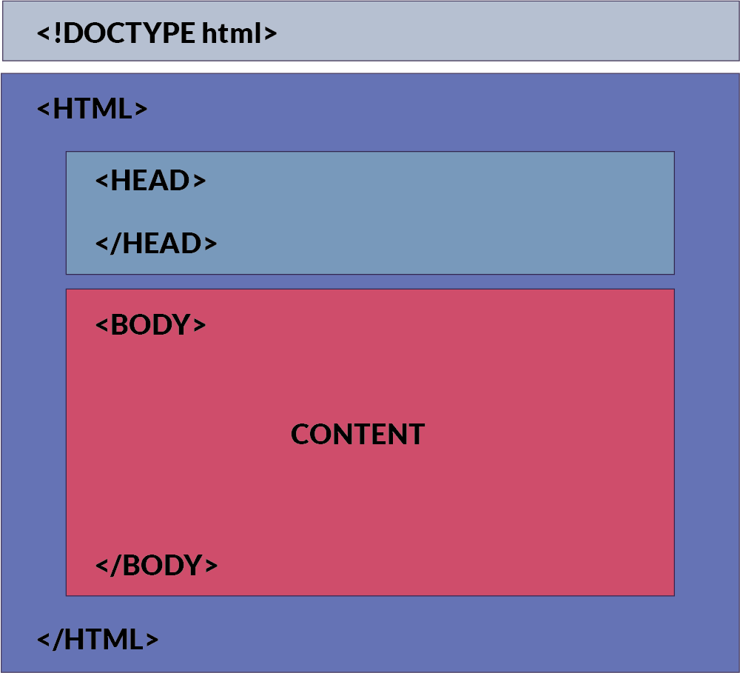

Slide 16
Conti.
HEAD section contains information about HTML which is mostly used by browser and search engines.
This information is not mean for the users and isn’t directly displayed to the user.
Body section mainly contains information which will be displayed to user.

Slide 17
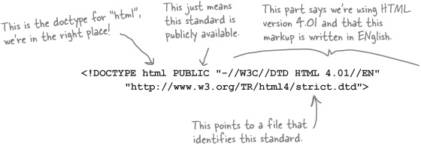
DOCTYPE - TAG

Slide 18
DOCTYPE - TAG
It is the starting tag in HTML file.
It tells the browser that this HTML document is an HTML 4.01 document which confirms to standards set by W3C and written in english language.

Slide 19
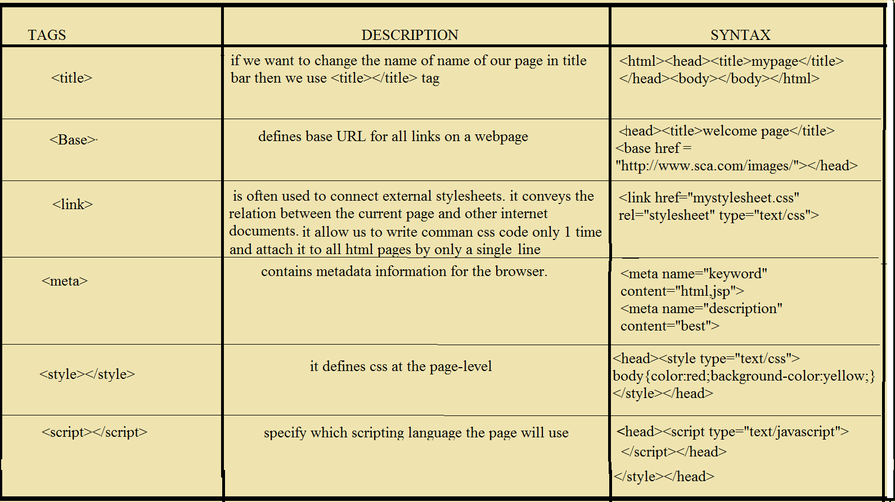
COMPONENT OF HEAD SECTION

Slide 20
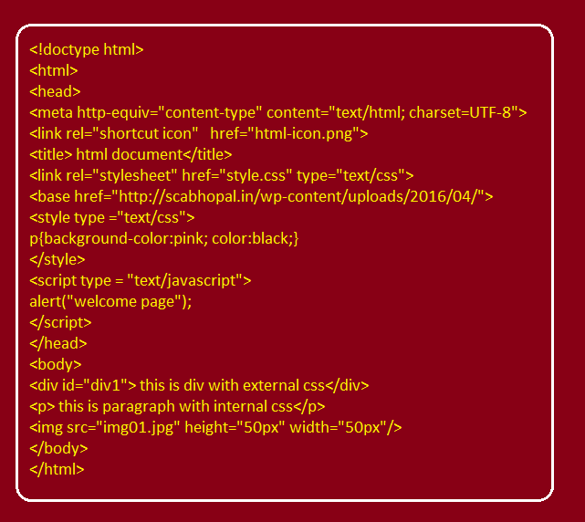
EXAMPLE PROGRAM

Slide 21
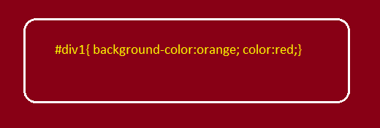
Style.css File

Slide 22
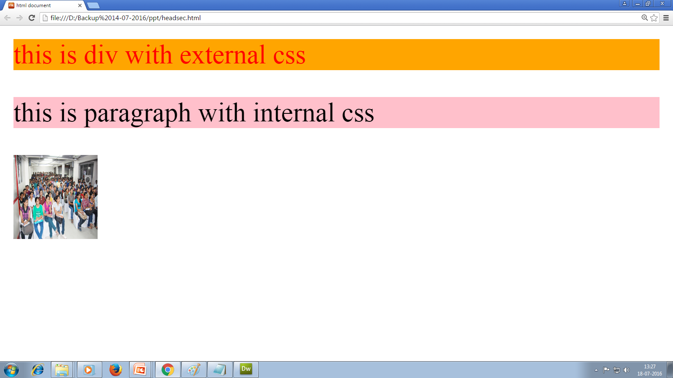
OUTPUT

Slide 23

End Of Lecture

